Slide 1

Report for SUSU Student Council
Joshie Christian
VP Education
18 / 02 / 26

Slide 2
New Buddy Schemes
(Q) Which departments are being targeted for new buddy schemes and how is this being decided?
Mass Emailing
(Q) Which schools/depts have had issues with all.soton mailing lists, and which ones are being supported to set up programme-level lists?
We have sorted issues in the following areas:
  Sociology, Social Policy, and Criminology.
  Economics.
  Languages, Cultures, and Linguistics.
  Allied Health Professions.
→ Prioritising based on peer support schemes and large cohorts.
→ Working case-by-case to address issues raised by Senior Reps.
→ Exploring new tools and planning how to promote wider usage!
all.soton.ac.uk/coursealias

Slide 3
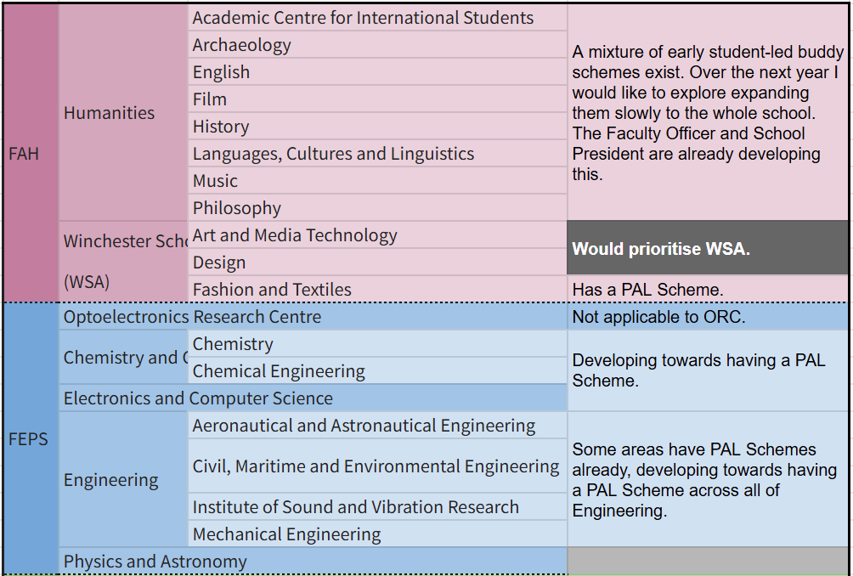
(Q) Which departments are being targeted for new buddy schemes and how is this being decided?

Slide 4
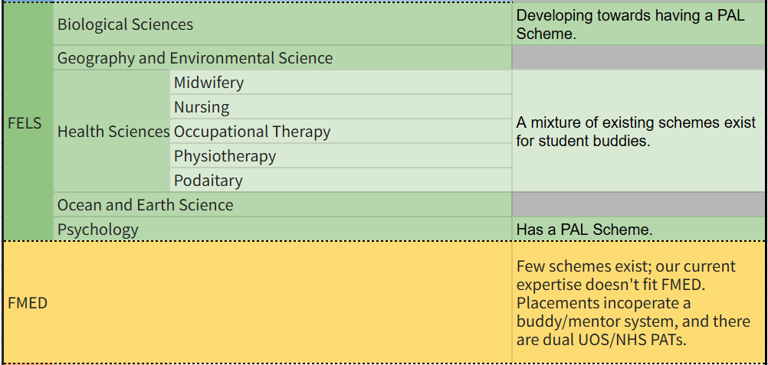
(Q) Which departments are being targeted for new buddy schemes and how is this being decided?

Slide 5
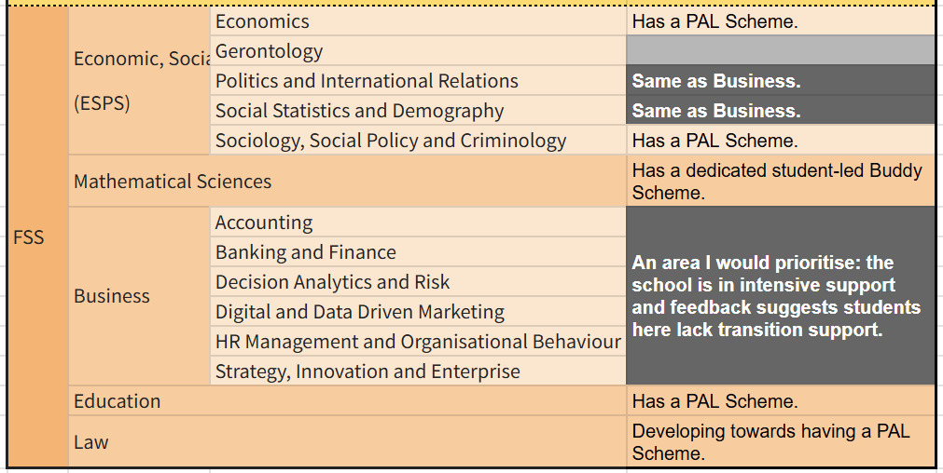
(Q) Which departments are being targeted for new buddy schemes and how is this being decided?

Slide 6
Thank you for listening!
Any further questions?
Joshie Christian
VP Education
18 / 02 / 26

